Slide 1
Capstone of ZUHA AHMAD
Statistics & Modeling
Coding with Performance on Big Data
Communicating Results for Decision-Making
Venn Diagram of Data Science Skills

Slide 2
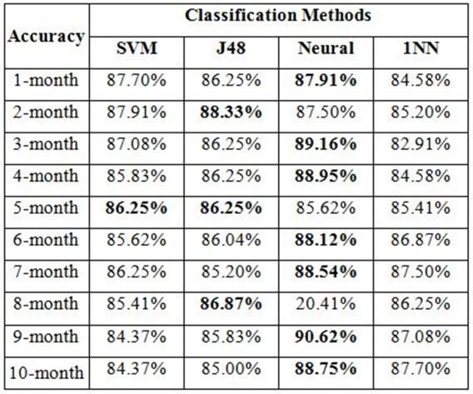
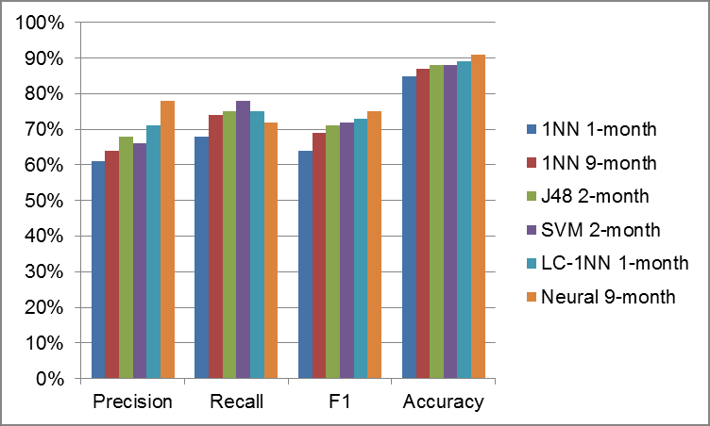
Contribution of Competitor’s Article
Best Overall Classifier Performance
Figure 7
Focus – Arrest, Commercial Burglary, Foreclosure, Motor Vehicle, Larceny, Residential Burglary, Street Robbery
Discuss approach to architecting dataset from original crime records
Perform an ensemble of data mining classification techniques to employ to perform crime forecasting
Propose the best forecasting to achieve the most stable outcomes
Figure 7.
Overall classification results.
Best performance of classifier using different training sets.
Yu, C. H., Ward, M. W., Morabito, M., & Ding, W. (2011, December). Crime forecasting using data mining techniques. In Data Mining Workshops (ICDMW), 2011 IEEE 11th International Conference on (pp. 779-786). IEEE.

Slide 3
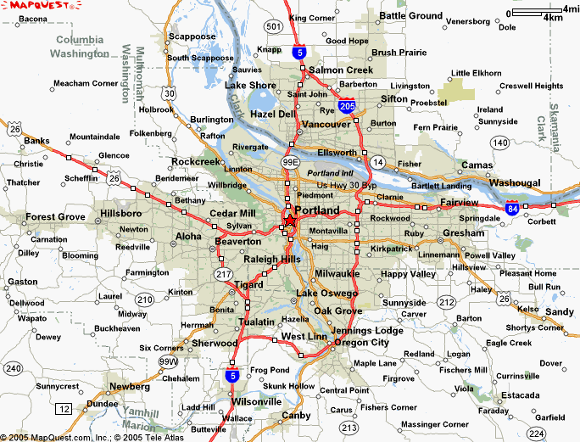
Description of Your Contribution
Generate crime forecasting in Portland, Oregon
Location (safe & unsafe areas)
Compare available crime forecasting methods
Improve place-based crime forecasting
Apply K-means clustering algorithm
Grouped the data for spatial ‘hotspot’
Create an application to visualize crime clusters in the city map

Slide 4
Data Source and Content
United States National Institute of Justice (USNIJ)
Provided by the Portland Police Bureau (PPB) for the period of March 1, 2012 through February 28, 2017. March 1, 2012 – February 28, 2017 (Updated) Variables in dataset included accident, burglary, cold stabbing, school disturbance(p), call disturbance(p), shooting(p), assault(p) * (p) = Priority

Slide 5
Your Method
Data Discovery
Data Preparation
Modeling
Evaluation
Deployment/ Operationalize

Slide 6
Quantitative Results 1
MAP KEY & LEGEND
1 incident
Accident (2012) | Accident (2012-2016)
1273 518 385 214 118 115 110 12 3 | 9,848 4,082 3,024 1,669 939 844 828 142 18 4
2-9 incidents
10-99 incidents
100+ incidents
- - - --- - Year 2012
Year 2012-2016

Slide 7
Quantitative Results 1
MAP KEY & LEGEND
Burglary (2012) | Burglary (2012-2016)
2340 1577 1025 663 103 70 47 | 15,789 11,235 7,076 4,880 1,548 1123 538
1 incident
2-9 incidents
10-99 incidents
100+ incidents
- - - --- - Year 2012
Year 2012-2016

Slide 8
Quantitative Results 1
MAP KEY & LEGEND
1 incident
Shooting (2012) | Shooting (2012-2016)
171 95 78 66 29 24 16 3 | 1,212 629 433 355 132 122 14 5 2 2
2-9 incidents
10-99 incidents
100+ incidents
- - - --- - Year 2012
Year 2012-2016

Slide 9
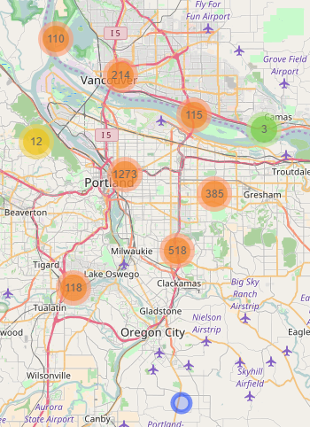
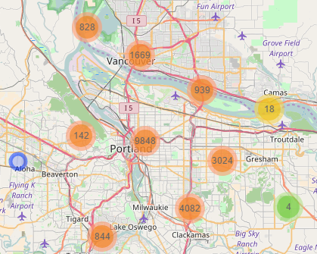
Quantitative Results 2
ACCIDENT

Slide 10
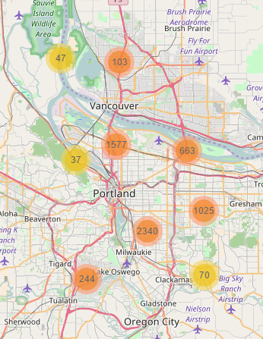
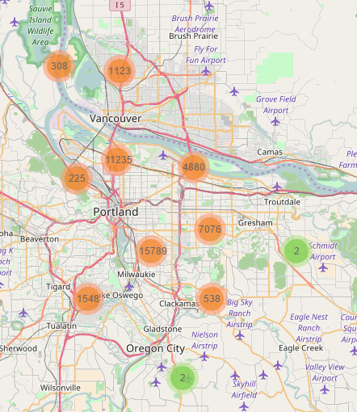
Quantitative Results 1
BURGLARY

Slide 11
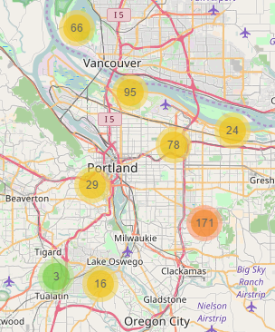
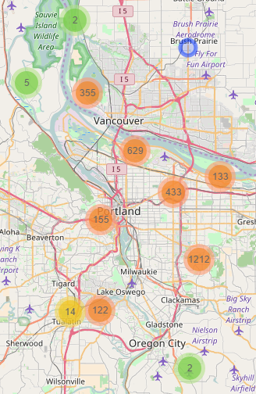
Quantitative Results 2
SHOOTING

Slide 12
Discussion: Comparison With Your Competitor
Competitor’s Results
Your Results
3 Results – Leveraging Spatial Knowledge
Success of the simple 1NN classifier modified with location constraint.
Finding the most similar circumstance within the same neighborhood proved more effective than finding it within the entire city.
Naive Bayes classifier yields better results than Neural Networks
24-by-20 grid data - Success measures are consistently higher when using lower resolution data set
Due to each grid cell exhibiting a broader spatial knowledge
K-Means Clustering was easily interpretable
Advantage: Simple, yet robust
Isolated variables in accordance with the map
Accident: Highest Cluster: 9,848; Lowest: 3
Burglary: Highest Cluster: 9,848; Lowest: 47
Shooting: Highest Cluster: 9,848; Lowest: 2

Slide 13
Performance on Big Data: Time Measurements
Operation | Application | Time Measurement
Load raw dataset in Spark | Zeppelin Notebook | 45 seconds
Load data | R | 1 minute
Aggregate data | R | 5 minutes
Loading server to map | R Shiny | 2 minutes

Slide 14
Conclusion
Identified crime clusters over a period of time
Majority of crime activities occur near the rivers
Lloyd district & pearl district is heavily impacted
Achieved results by updating data that is supplied into the application
Cooperation of law enforcement between Oregon and Washington due to Inter-State crime
Further studies are in urgent need to understand mechanisms for crime insurance and law and governmental policies

Slide 15
Quiz for Your Classmates
What statistical method was used?
What programming tool was used?
What scientific contribution was made?
What idea could be useful for your project?

